Slide 2
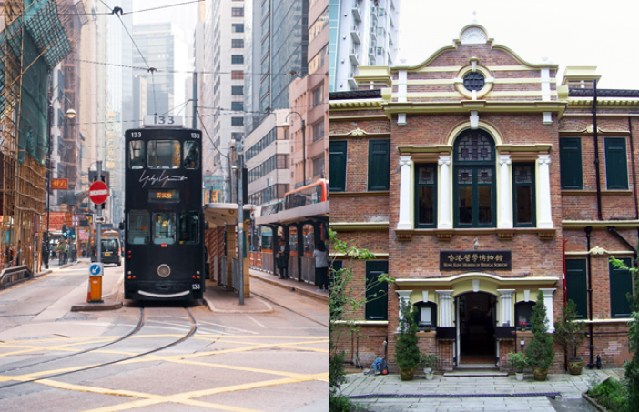
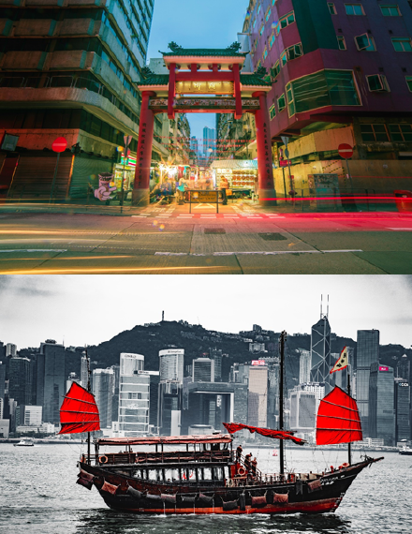
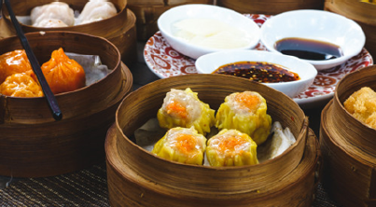
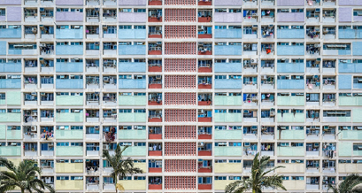
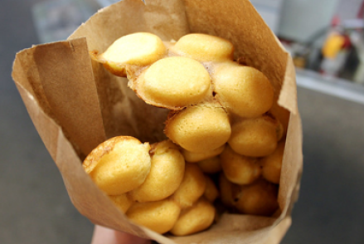
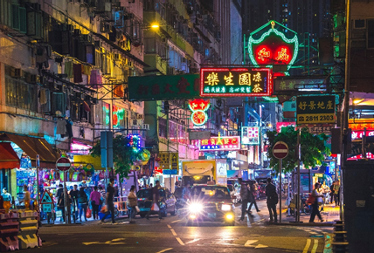
About Hong Kong
Economy
Population
Geography
Ranks 7th in list of world’s most competitive economies (2023)
Approx. 7.5 million
261 outlying islands
Unforgettable
Foodie Encounters
Authentic
Local Culture
Stunning Skyline &
Breathtaking Landscapes
Eastern and Western Culture

Slide 3
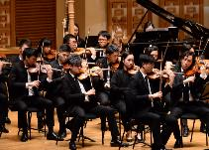
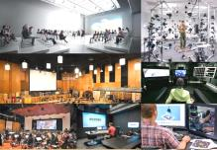
About HKBU
7 Faculties
Faculty of Arts
School of Business
School of Chinese Medicine
School of Communication
School of Creative Arts
Faculty of Science
Faculty of Social Sciences
23rd in QS Top 50 under 50 (2021)
64th in QS Asia (2024)
Fully Government-funded
Unique Downtown Location
Medium of instructions: English

Slide 5
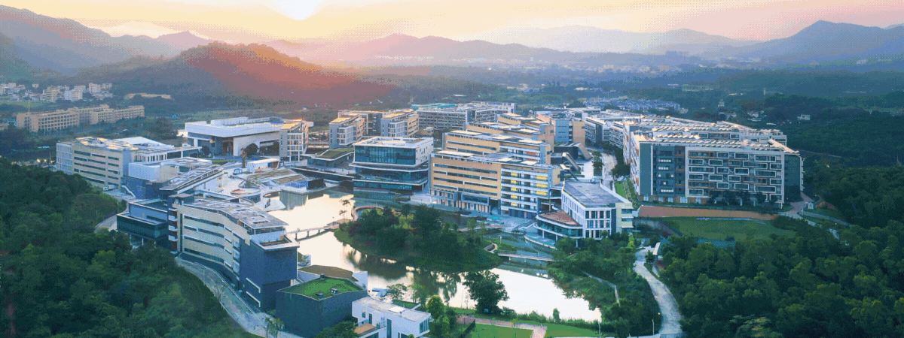
Beijing Normal University-Hong Kong Baptist University United International College (UIC)
HKBU Zhuhai Campus

Slide 6
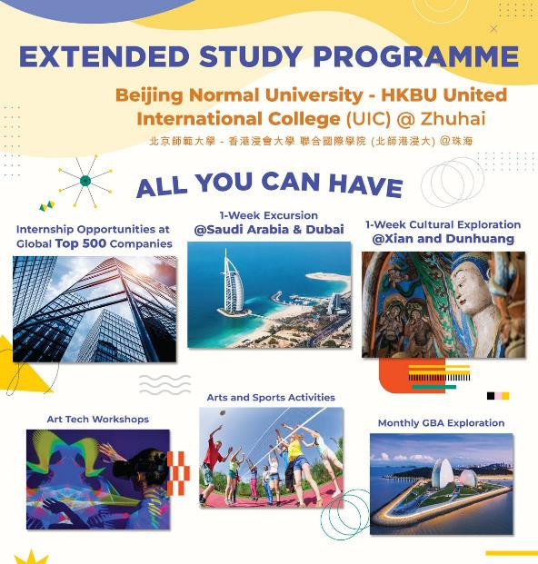
HKBU Extended Study Programme Full Academic Year Exchange Student
A unique programme which spans two dynamic cities – Hong Kong and Zhuhai

Slide 7
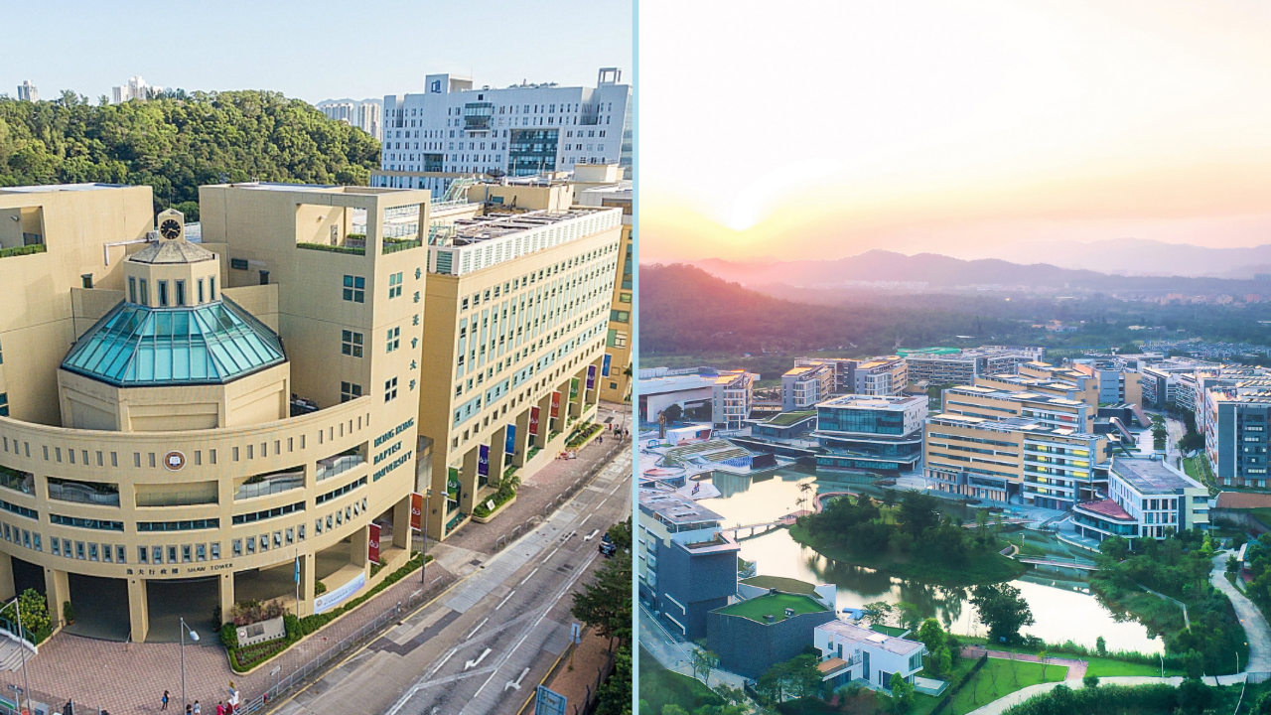
1 Programme, 2 Cities Experience HKBU X Zhuhai Campus (UIC)
Extended Study Programme
For Full Academic Year Exchange Student
1st Semester – Stay with us @HKBU
2nd Semester –
Option 1: Continue studying @HKBU
Option 2: Study @Zhuhai Campus
Culture Immersive Tour – 3 Days Trip to Zhuhai Campus
For Full Academic Year & Semester Exchange Student
3 Days Trip to Zhuhai Campus

